Slide 1
Abstract Class

Slide 2
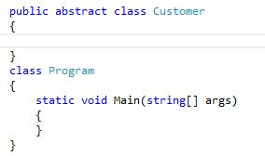
To create an abstract class we use abstract keyword

Slide 3
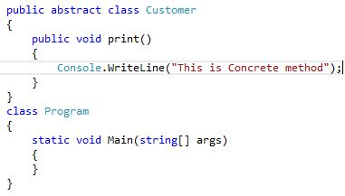
An abstract class can contain both abstract and non abstract member

Slide 4
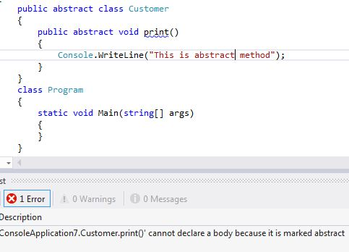
Abstract method can not have implementation

Slide 5
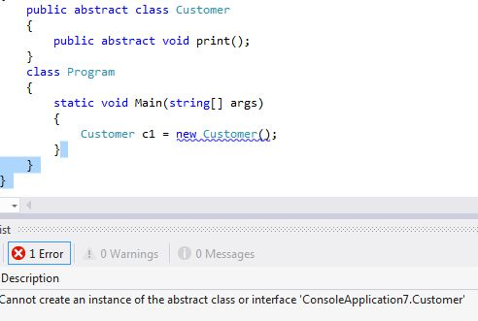
We can not create an instance of abstract class

Slide 6
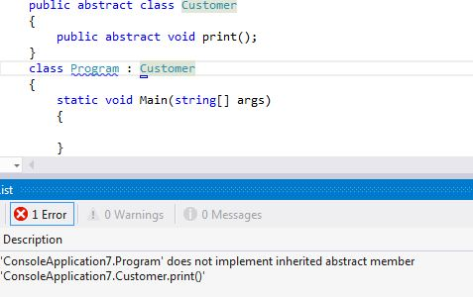
If a concrete class inherit an abstract class then the concrete class should implement all the abstract method of the abstract class

Slide 7
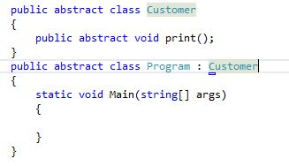
If we do not want to implement the abstract method then turn the class to abstract as well

Slide 8
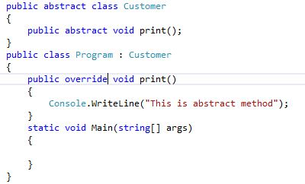
How to implement an abstract method

Slide 9
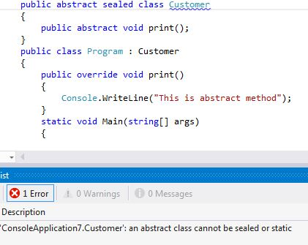
An abstract can not be declared as sealed because sealed class can not be inherited and abstract class is used only base class purpose

Slide 10
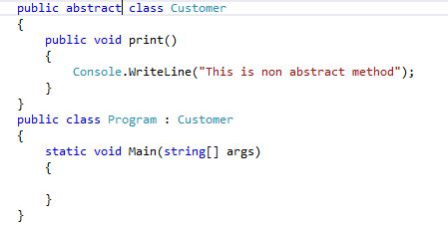
An abstract class may not contain any abstract member

Slide 11
Differences between abstract class and interface

Slide 12
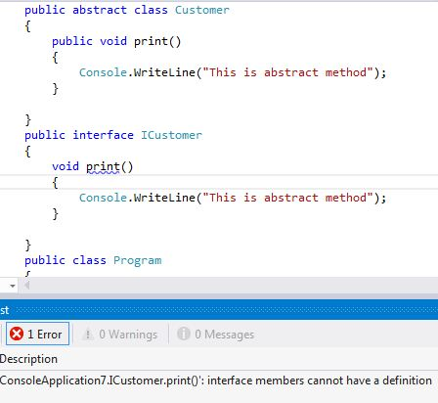
Abstract class can have implementation for some of its members but interface can not have implementation for any of its members

Slide 13
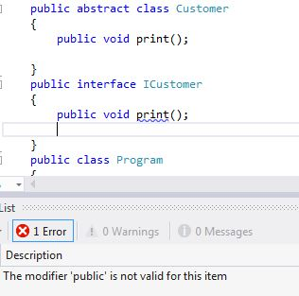
Abstract class members can have access modifier while interface members can not have it

Slide 14
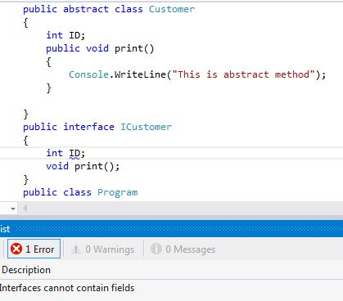
Abstract class can have field but interface can not have field

Slide 15
Implement without Inheritance

Slide 16


Slide 17


Slide 18


Slide 20
Implement with Inheritance

Slide 21
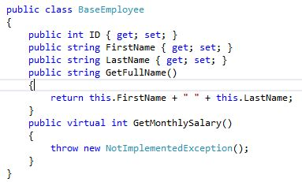

Slide 22
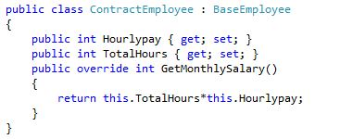
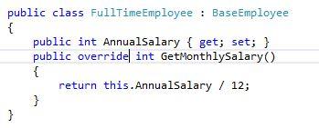

Slide 24
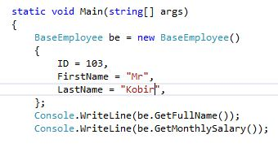
What is the problem?

Slide 25
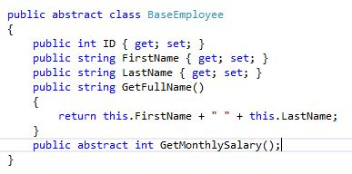
Implementation Using Abstract class

